Slide 1
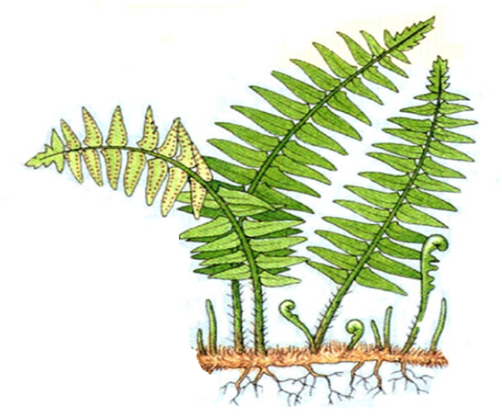
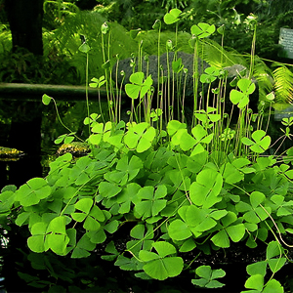
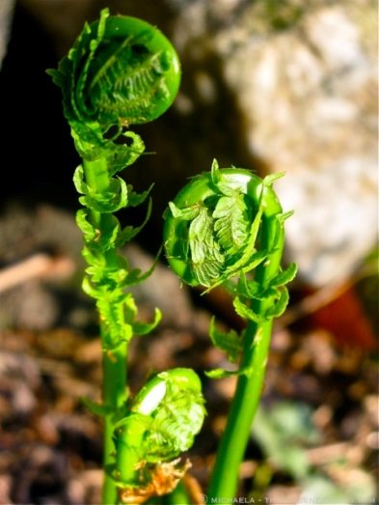
Pteridophyta
In this group, the plant body is differentiated into roots, stem and leaves and has specialised tissue for the conduction of water and other substances from one part of the plant body to another.
Some examples are Marsilea, ferns and horse-tails

Slide 2
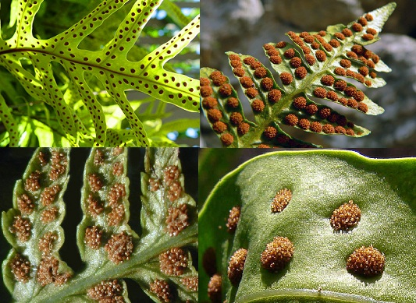
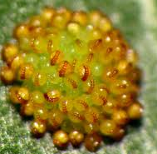
The thallophytes, the bryophytes and the pteridophytes have naked embryos that are called spores.
The reproductive organs of plants in all these three groups are very inconspicuous, and they are therefore called ‘cryptogamae’,
Not clearly visible

Slide 3
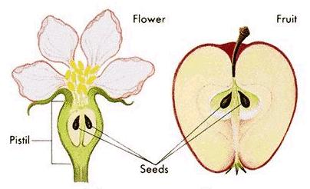
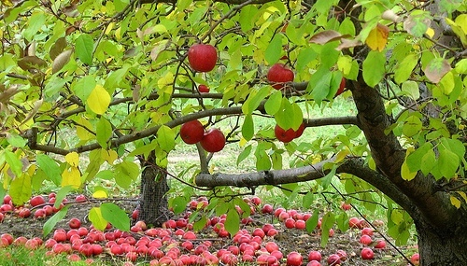
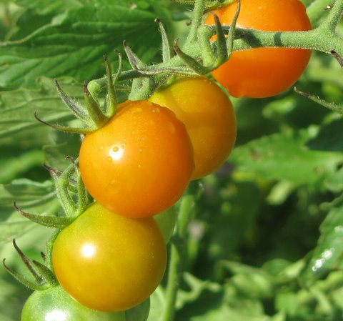
On the other hand, plants with well differentiated reproductive tissues that ultimately make seeds are called phanerogams.
Seeds are the result of the reproductive process.
They consist of the embryo along with stored food, which serves for the initial growth of the embryo during germination.
This group is further classified, based on whether the seeds are naked or enclosed in fruits, giving us two groups: gymnosperms and angiosperms

